Slide 1

Cypurr Sessions
No Clouds, No Masters
May 13th, 2018
Notes:
“La ingeniería de eq de fases comprende la aplicación del conocimiento fenomenológico del comportamiento de sistemas homogéneos y multifásicos, y su predicción mediante herramientas termodinámicas, con la finalidad de contribuir al desarrollo de procesos químicos. El diseño del equilibrio de fases es un nexo entre los requerimiento de un dado proceso y las actividades académicas de medición y modelado de datos experimentales.
[…] Esta disponibilidad (de simuladores computacionales) hace necesario estudiarla, con la finalidad de alcanzar un uso más fehaciente y efectivo de éstos, a través del desarrollo de criterios generales que faciliten la comprensión del potencial y limitaciones del proceso químico.”
Pereda, tesis doctoral, PLAPIQUI/UNS 2003, pp 4.1.

Slide 2

WELCOME!

Slide 3

Outline
Introduction
Rules n’ Such
Current Events
No Clouds, No Masters
Mini Workshops
VPN/Tor 101
Terms of Service for Smarties!
Thank You/Resources
Notes:
Ability concerns contact
Assisting with needs
Breaks
“Can everyone see [me/ the board/ the screen/ the main point of focus]?”
“Can everyone hear me at this volume? Am I speaking at a good pace?”
New words/phrases

Slide 4
Who are we? Who are you?
We are the…
The Cypurr Collective: A group of folks that organize cybersecurity workshops and socials, looking to spread knowledge and talk about privacy rights!
...and you are?
Name
Pronouns (i.e. he/him, she/her, they/them, ze/zer, etc)
In a few words, what brings you here today?

Slide 5

A few rules for this workshop …
Share the space!
Step Up Step Back: Ask a question, give a comment, leave room for others to speak
Stack!
Raise your hand and we will put you on the speaking queue
Saf(er) Space
We DO NOT tolerate language or behavior purposefully meant to demean or harm folks based on their identities
No one should be forced to discuss their own experience/threat model/situation
Consent: Ask before helping someone out, before taking their device
Photo/Video- No photo/video without asking!
Bonus Rule: Try not to invalidate experiences!

Slide 6
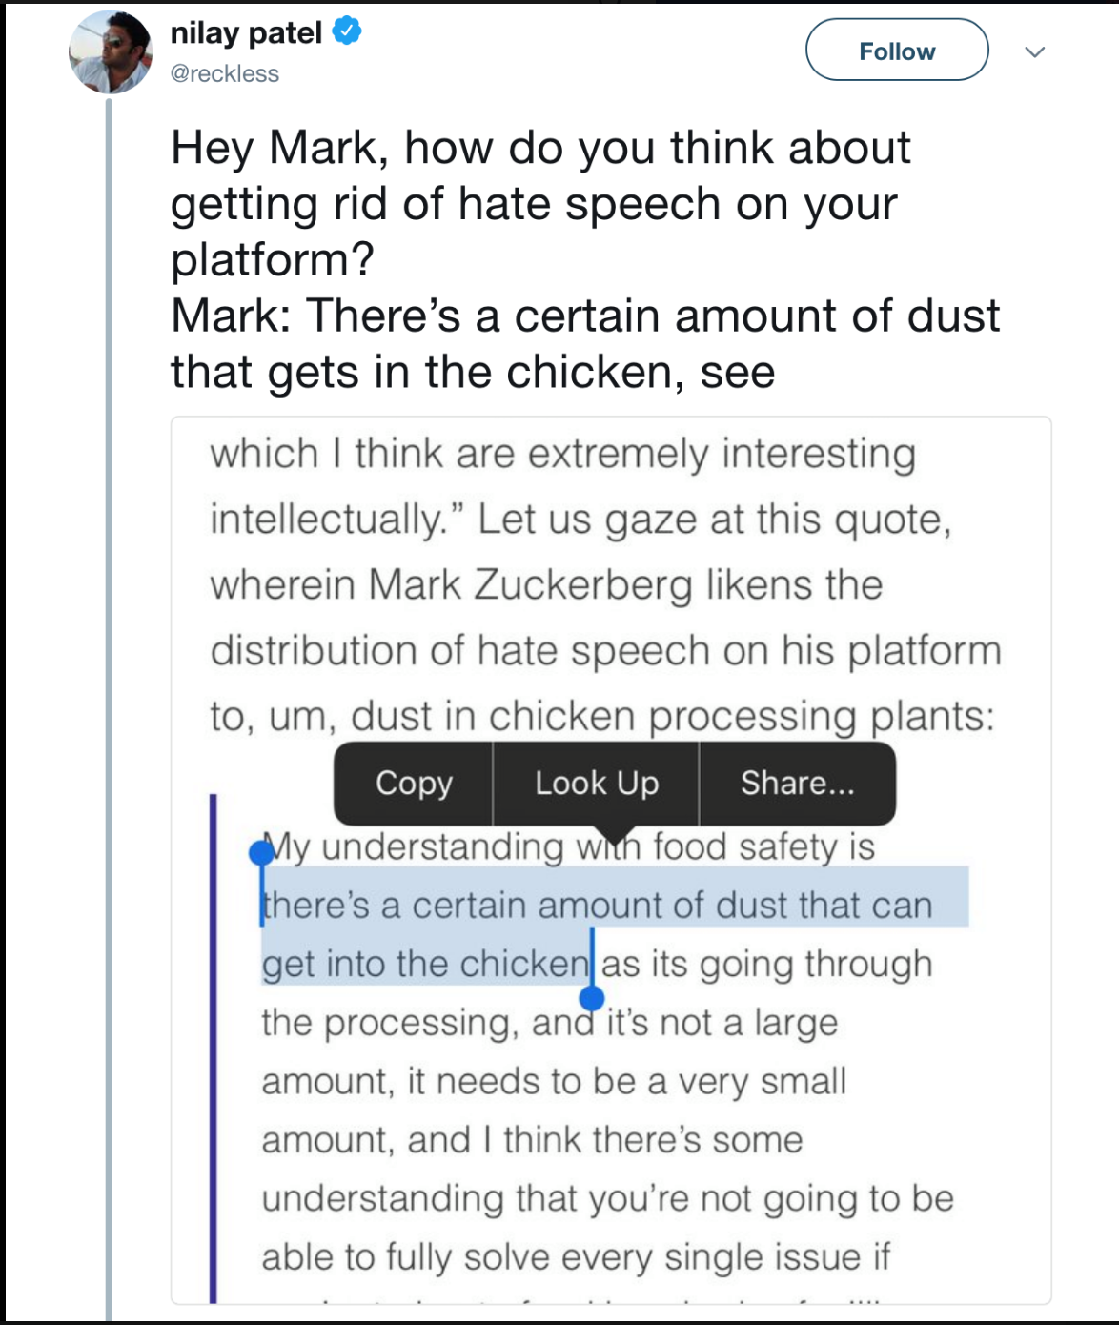
Current Events!

Slide 7

WHAT’S ON YOUR MIND?

Slide 8

Story #1: Warning Signals
Amazon blocks domain fronting, threatens to shut down Signal’s account,
Ars Tecnica
May 2nd, 2018

Slide 9
The Story
Amazon announced a change designed to end the use of domain fronting
What is Domain Fronting?
the exploitation of a content delivery network’s architecture to conceal the actual destination of encrypted Internet traffic.
Amazon issued a warning to the developers of the Signal encrypted phone and messaging application that it would cancel Signal's CloudFront account if the service continued to attempt to evade censorship using Amazon's sites as cover.
Signal uses CloudFront to handle load balancing of its servers, none of which has a permanent IP address.

Slide 10
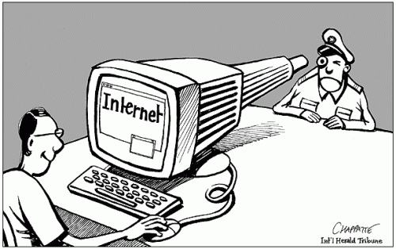
The Threat
Censorship of communication apps!
Signal used Amazon and Google services to circumvent censorship for folks with phone numbers in countries like UAE and Egypt
These countries could not censor Signal without censoring Google or Amazon domains entirely

Slide 11

What Can be Done?
It doesn’t look like there’s an immediate solution on the horizon.
“In the meantime, the censors in these countries will have (at least temporarily) achieved their goals. Sadly, they didn’t have to do anything but wait,” says Marlinspike.

Slide 12
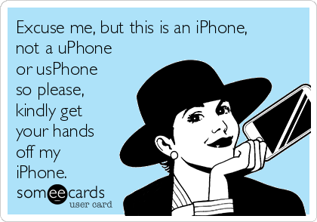
Story #2: CBP has to follow rules (WAAAAAAAA!!!)
Another Federal Court Rules the Fourth Amendment Applies at the Border
ACLU
May 9th, 2018

Slide 13
The Story
A federal appeals court in Virginia ruled that under the Fourth Amendment, U.S. border authorities cannot search travelers’ cell phones and other electronic devices without individualized suspicion of wrongdoing.
“In the case, United States v. Kolsuz, border agents stopped a traveler as he boarded an international flight at Dulles Airport and found firearm parts in his checked luggage, which they suspected he lacked a license to export. Without obtaining a search warrant, agents seized the traveler’s phone, briefly searched it at the airport, and then sent it to a separate facility where investigators conducted a thorough “forensic” search of all of the data saved on the device. That included all of the traveler’s “personal contact lists, emails, messenger conversations, photographs, videos, calendar, web browsing history, and call logs, along with a history of [his] physical location down to precise GPS coordinates.”

Slide 14


What’s It Mean?
The government should have been required to get a search warrant from a judge.
Border agents must demonstrate good reason to believe the traveler was violating the law before conducting the search.
ACLU the court to reject the government’s argument that cell phones should be treated the same as regular luggage, which border authorities are routinely allowed to search without a warrant or any individualized suspicion.

Slide 15

What Can be Done?
The Fourth Circuit’s decision is a significant step in the right direction, but more clarity is needed.
The ACLU, along with the Electronic Frontier Foundation, has sued the federal government on behalf of 11 people who were subjected to suspicionless searches of their phones and laptops when coming home to the U.S.
Requiring border agents to get a warrant based on probable cause is the only way to fully ensure that travelers’ Fourth Amendment rights are not violated just because they find themselves at the border.

Slide 16
STRETCH BREAK

Slide 17

No clouds no Masters
GDPR, CLOUD ACT, and privacy across borders

Slide 18

GDPR
GDPR- General Data Protection Regulation
Becomes enforceable in E.U on May 25th 2018
Will also apply to organizations located outside of the EU if they offer interact with EU
Rights
To be informed
Access
Rectification
Erasure (a.k.a right to be forgotten)
Restrict Processing
Portability
To Object
Automated Decision Transparency
Accountability
Transfer of Data
Breach Notification
Notes:
Facebook has known about this issue since 2015
Recent busted for getting Android users phone info
Promising to make privacy easier

Slide 19
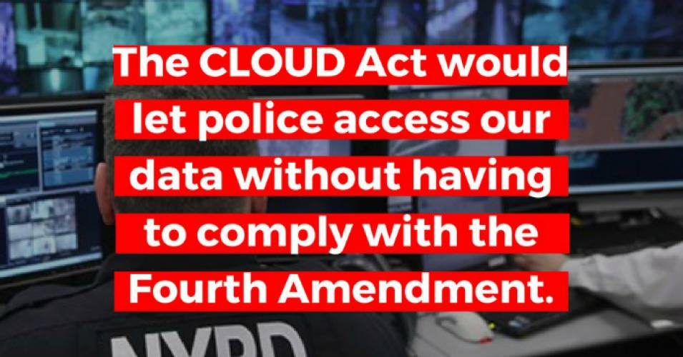
Cloud Act
Clarifying Overseas Use of Data
Expands American and foreign law enforcement’s ability to target and access people’s data across international borders
provision for U.S. law enforcement to access information” about a person regardless of where they live or where that information is located on the globe
allow the President to enter into “executive agreements” with foreign governments that would allow each government to acquire users’ data stored in the other country, without following each other’s privacy laws.
Notes:
Facebook has known about this issue since 2015
Recent busted for getting Android users phone info
Promising to make privacy easier

Slide 20
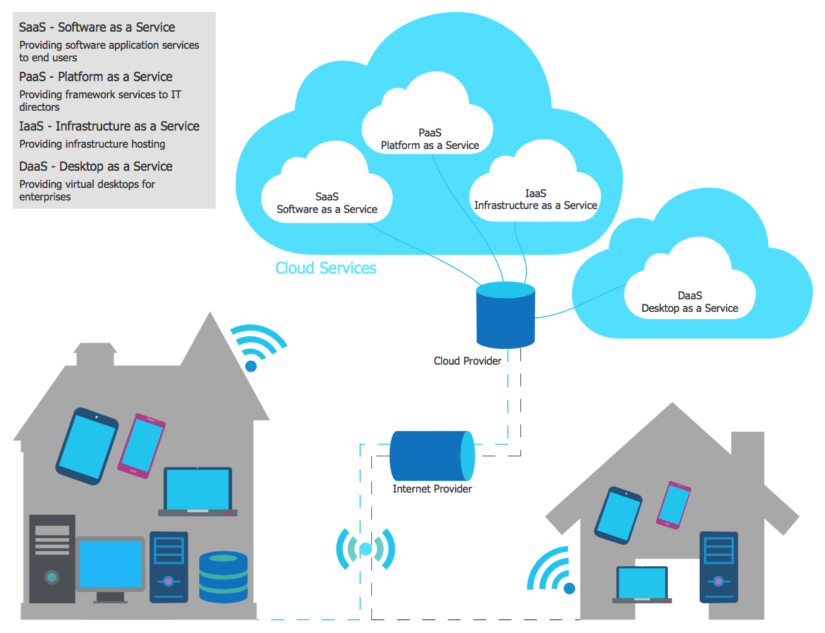
Notes:
Facebook has known about this issue since 2015
Recent busted for getting Android users phone info
Promising to make privacy easier

Slide 21

A World of Issues

Slide 22
Mini Workshops!
1)Intro to Tor/VPN
2) Terms of Service and YOU!

Slide 23
Thank You and Resources
CyPurr Collective on Facebook Twitter for Future events!
Sign up to our email list too, we won’t spam ya!
Further Resources
NYC CryptoParty Meetup/CryptoParty Harlem (Meetup)
HacbBlossom (Hackblossom.org)
Tactical Tech Collective-
Holistic Security,
MyShadow
Data Detox
EFF- Surveillance Self Defense (ssd.eff.org)
Freedom of the Press Foundation (Freedom.press)
T4Tech

Slide 24
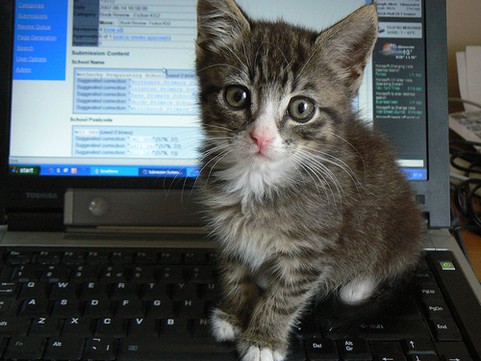
Thank You!

